Slide 1
Security as an Edge Service
Aug 07, 2018
Wenhui Zhang, John Craig, Kandan Kathirvel

Slide 2
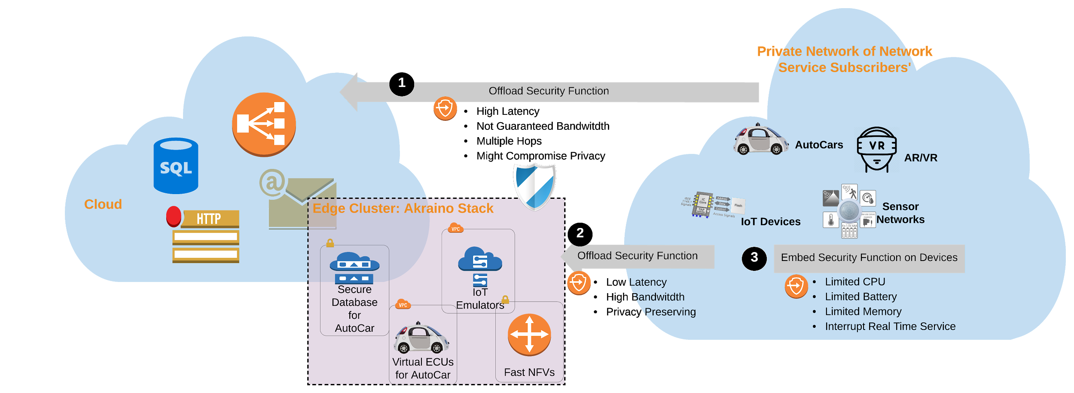
Edge as a Defense
Offload Security Functionalities to Edge
© 2018 AT&T Intellectual Property. All rights reserved. AT&T, Globe logo, Mobilizing Your World and DIRECTV are registered trademarks and service marks of AT&T Intellectual Property and/or AT&T affiliated companies. All other marks are the property of their respective owners. AT&T Proprietary (Internal Use Only). Not for use or disclosure outside the AT&T companies except under written agreement.
Notes:
Key points:
- AEC is critical
- AEC intercepts all key edge needs

Slide 3
Threat Model: Intrusion Detection
Intrusion is an authorized action exploits a vulnerability, and causes a compromise. Thus a successful attack.
Stipulations on which our model is built:
Network communication with cloud is malicious
Akraino Stack is secure
Containers are benign (they are not controlled by active hackers)
Edge Service Subscriber Devices are vulnerable
Authentication and Access Control Are No Help!
© 2018 AT&T Intellectual Property. All rights reserved. AT&T, Globe logo, Mobilizing Your World and DIRECTV are registered trademarks and service marks of AT&T Intellectual Property and/or AT&T affiliated companies. All other marks are the property of their respective owners. AT&T Proprietary (Internal Use Only). Not for use or disclosure outside the AT&T companies except under written agreement.
Notes:
Key points:
- AEC is critical
- AEC intercepts all key edge needs

Slide 4
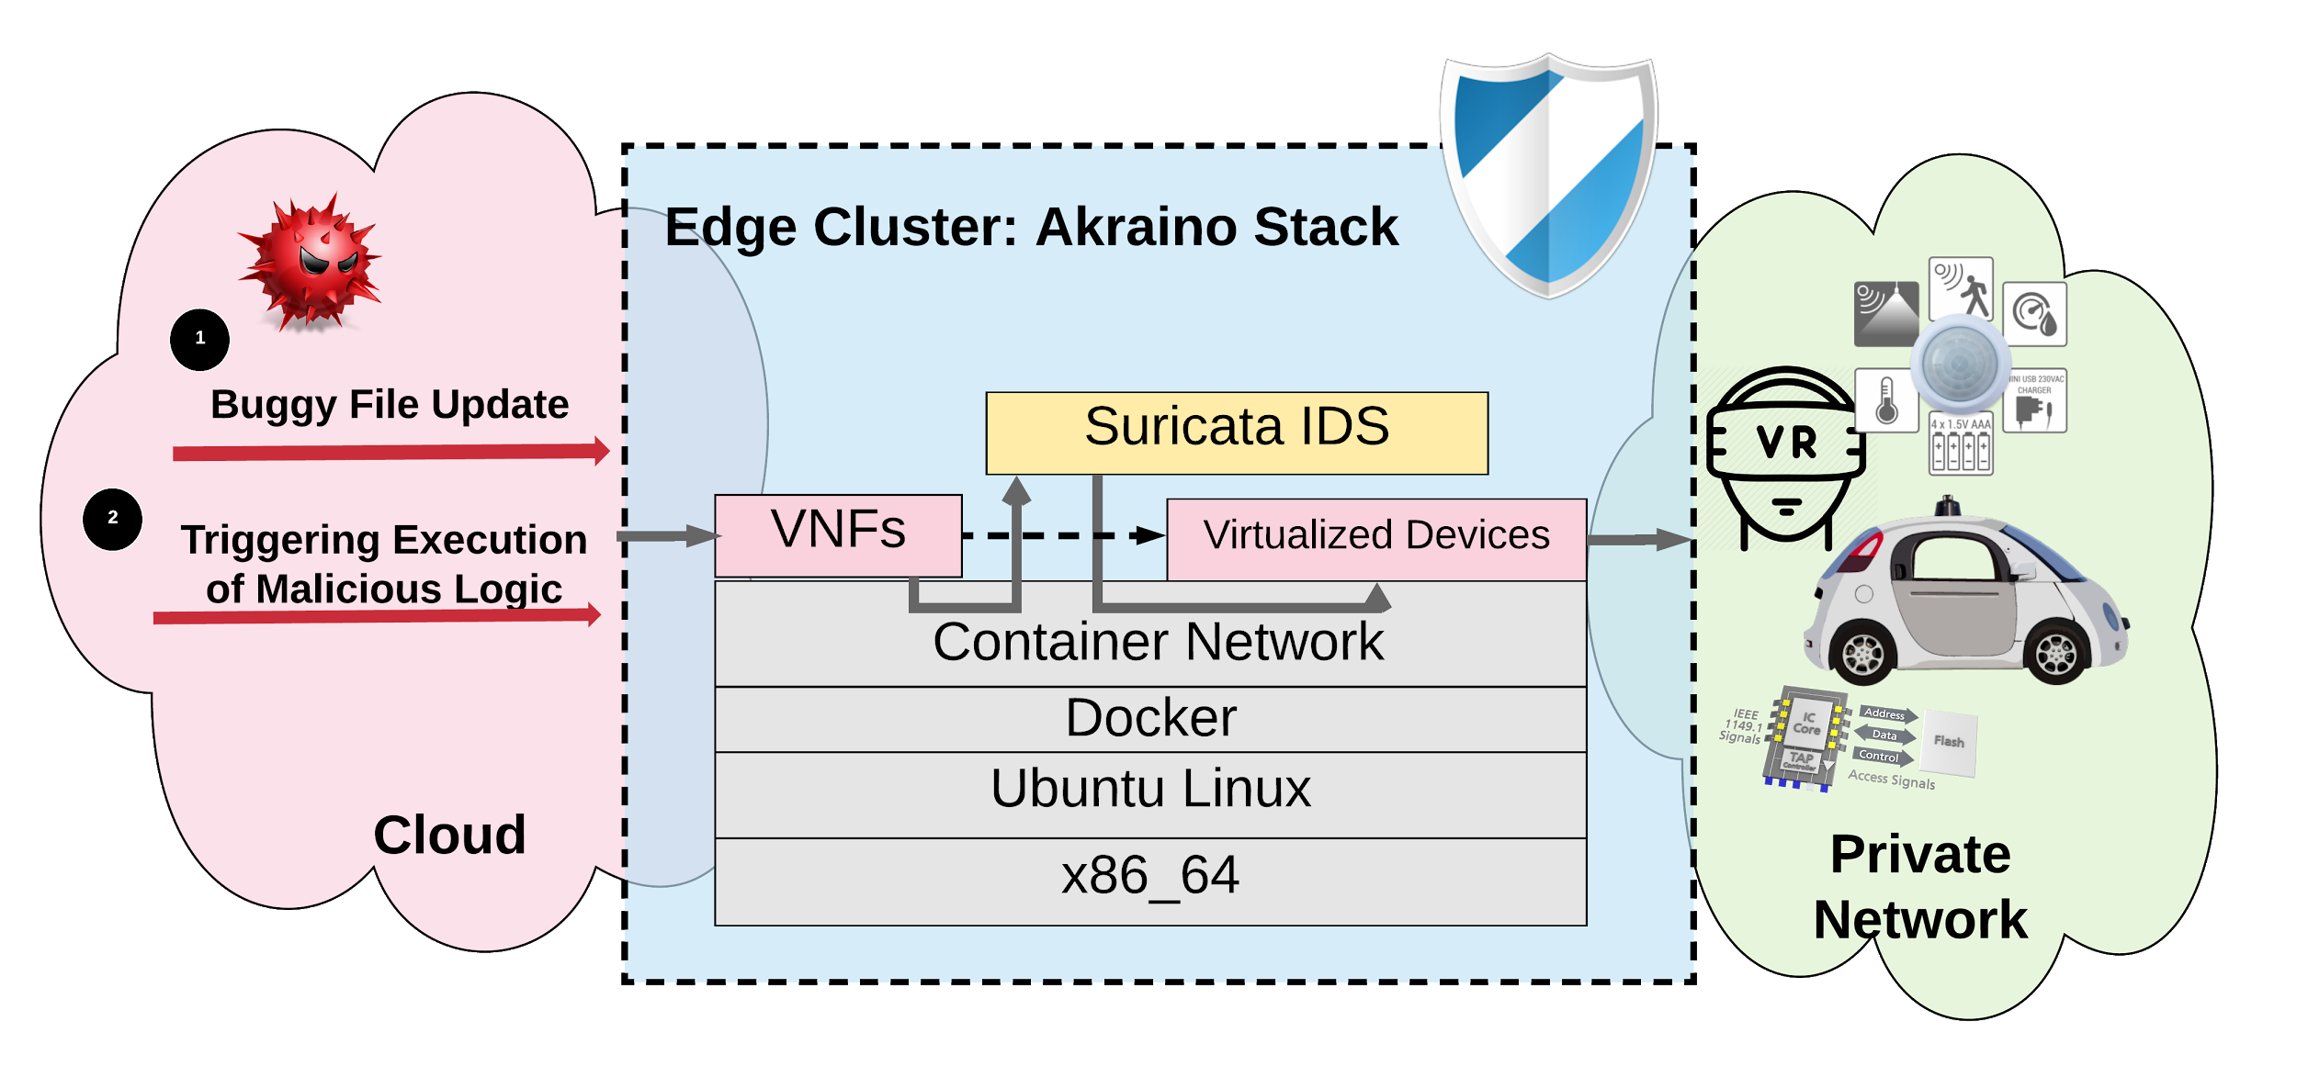
Architecture of prob-C
• Build Suricata Docker with latest Signature Database
• Performance Test with Various Core Affinity
• Stress Test with Kernel Bypassing Netmap + VALE + pkt-gen
• Effectiveness Test with Malicious pcap
• Developed AutoSplitting and Data Aggregation for Performance Evaluation
© 2018 AT&T Intellectual Property. All rights reserved. AT&T, Globe logo, Mobilizing Your World and DIRECTV are registered trademarks and service marks of AT&T Intellectual Property and/or AT&T affiliated companies. All other marks are the property of their respective owners. AT&T Proprietary (Internal Use Only). Not for use or disclosure outside the AT&T companies except under written agreement.
Notes:
Key points:
- AEC is critical
- AEC intercepts all key edge needs

Slide 5
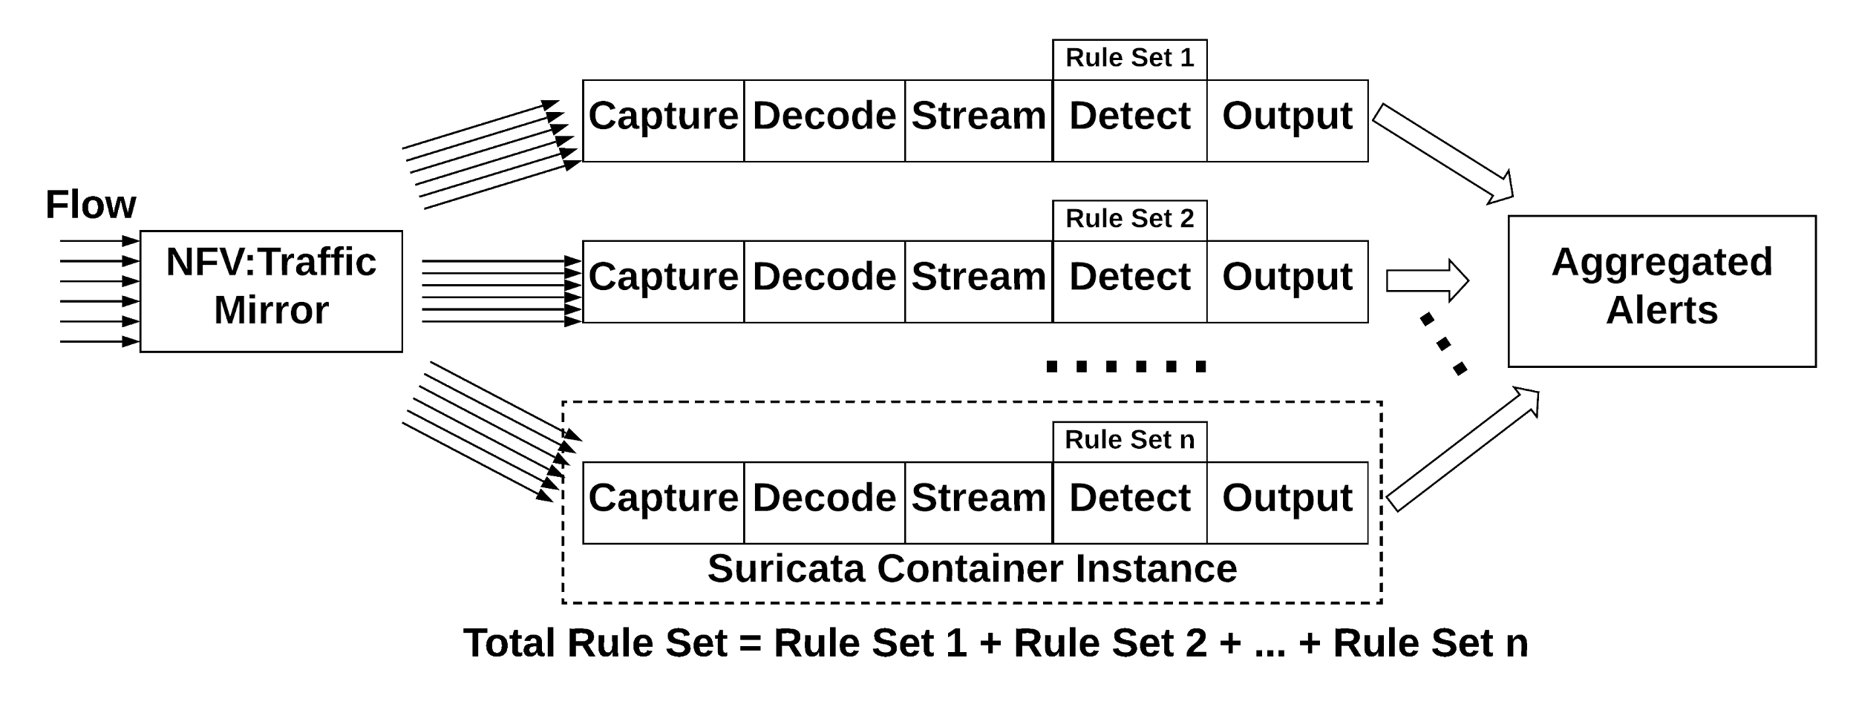
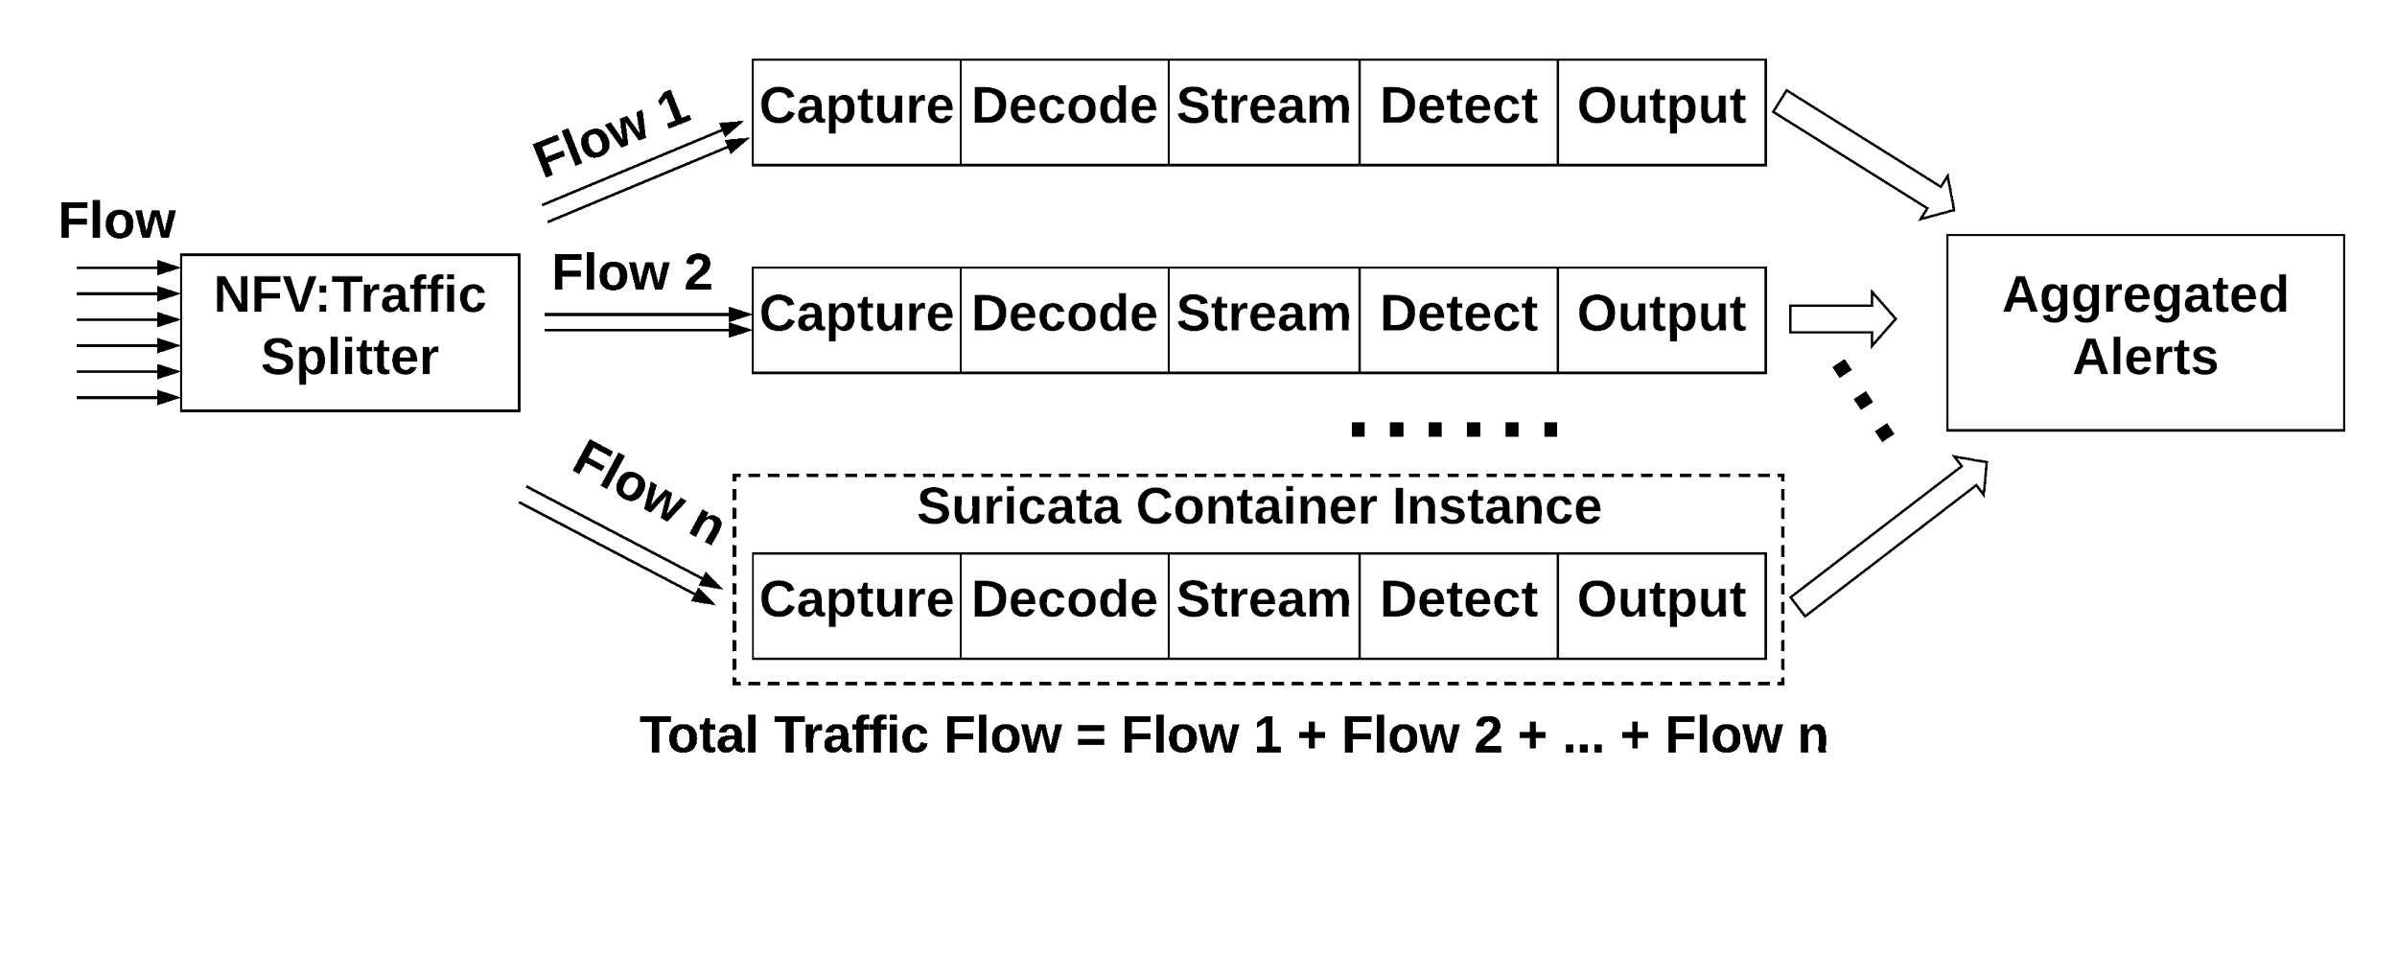
Understanding Bottlenecks
Design Requirement of Architecture to Support 5G
Peak data rates at 20 Gbits/s
Support low latency with less than 5ms
Understanding Bottlenecks
Network
Disk I/O
CPU
Memory
Two ways of Enhancing Scalability in IDS
Splitted Functionalities in Multi-threaded IDS
Splitted Flows in Multi-threaded IDS
https://www.qorvo.com/design-hub/blog/getting-to-5g-comparing-4g-and-5g-system-requirements
© 2018 AT&T Intellectual Property. All rights reserved. AT&T, Globe logo, Mobilizing Your World and DIRECTV are registered trademarks and service marks of AT&T Intellectual Property and/or AT&T affiliated companies. All other marks are the property of their respective owners. AT&T Proprietary (Internal Use Only). Not for use or disclosure outside the AT&T companies except under written agreement.
Notes:
Key points:
- AEC is critical
- AEC intercepts all key edge needs

Slide 6
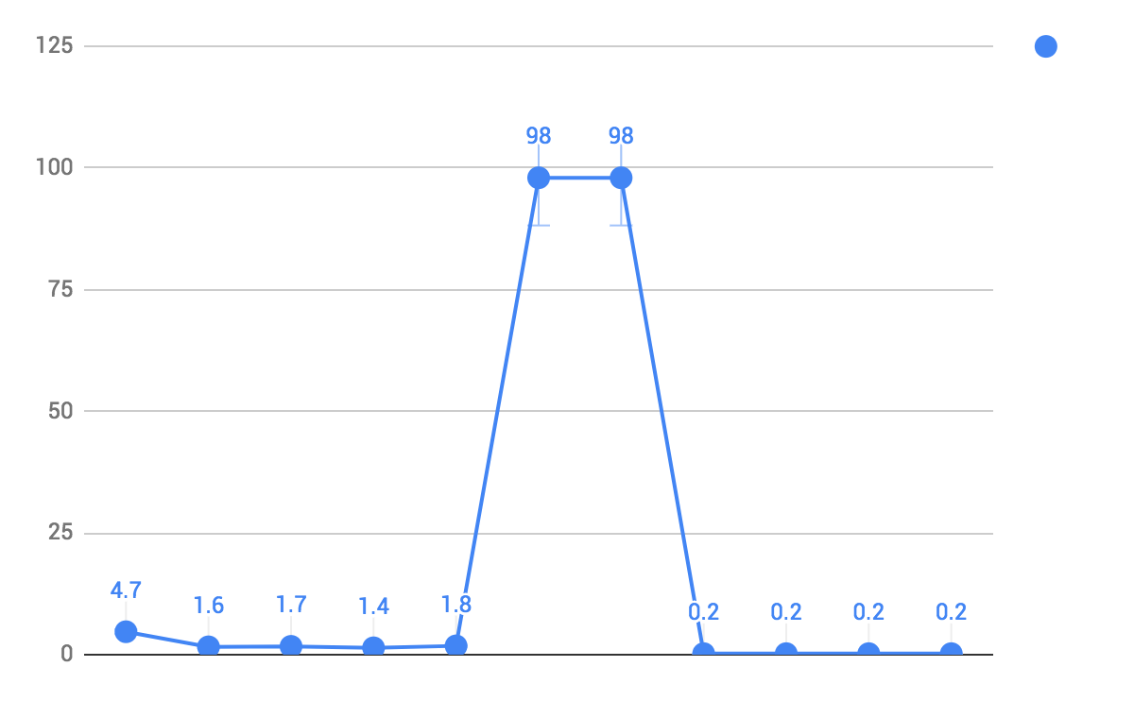
Understanding Bottlenecks
Understanding Bottlenecks
Memory: 0.2% on average
Disk I/O: N/A
CPU: see fig.
Network
64 bytes/packet, host is 9.8G/s, container is 0.8G/s
1004 bytes/packet, host is 59G/s, container is 2G/s
31 secs for a 2 hours of capture, 21G, 4 secs bootup, 1 secs of joining, avg 5.24G/s [02:23:11.48-04:23:11.42]
CPU Utilization
processing
thread joining
starting
Pinned to one core 0: taskset -p 0x01 pid_suri_docker
Test File: Botnet-capture-20110810-neris.pcap
Network is the Bottleneck
© 2018 AT&T Intellectual Property. All rights reserved. AT&T, Globe logo, Mobilizing Your World and DIRECTV are registered trademarks and service marks of AT&T Intellectual Property and/or AT&T affiliated companies. All other marks are the property of their respective owners. AT&T Proprietary (Internal Use Only). Not for use or disclosure outside the AT&T companies except under written agreement.
Notes:
Key points:
- AEC is critical
- AEC intercepts all key edge needs

Slide 7
Understanding Bottlenecks : Explained
Hinder Factors:
Copy between userspace and kernel space
alleviated by kernel bypassing techniques, e.g. DPDK + OVS; Netmap + VALE
Context Switch
alleviated by pinning to certain core
Disk I/O
introduced by tcpdump and then replay, alleviated by real time environment test, and adding cached flag with suricata
Lessons from past, no VMs w/ SR-IOV, still prefers containers
Bottleneck between VMs’ traffic forwarding
Dynamic chaining of VMs, booting VMs is slow
Zhang, W., Liu, G., Zhang, W., Shah, N., Lopreiato, P., Todeschi, G., ... & Wood, T. (2016, August). OpenNetVM: A platform for high performance network service chains. In Proceedings of the 2016 workshop on Hot topics in Middleboxes and Network Function Virtualization (pp. 26-31). ACM.
Kernel Bypassing Achieves Zero Copy
© 2018 AT&T Intellectual Property. All rights reserved. AT&T, Globe logo, Mobilizing Your World and DIRECTV are registered trademarks and service marks of AT&T Intellectual Property and/or AT&T affiliated companies. All other marks are the property of their respective owners. AT&T Proprietary (Internal Use Only). Not for use or disclosure outside the AT&T companies except under written agreement.
Notes:
Key points:
- AEC is critical
- AEC intercepts all key edge needs

Slide 8
Summary
Understanding Bottlenecks
Memory: 0.2% on average
Disk I/O: N/A
CPU: 1.4% pin to one core, during processing
Network:
64 bytes/packet, host is 9.8G/s, container is 0.8G/s
1004 bytes/packet, host is 59G/s, container is 2G/s
31 secs for a 2 hours of capture, 21G, 4 secs bootup, 1 secs of joining, avg 5.24G/s [02:23:11.48-04:23:11.42]
Estimation: to achieve 20G/s
Splitting Traffic: if splitting is fast enough, 4 suricata containers will be enough for 20G (4*5.24 > 20G)
Parallel Probs: 12 suricata containers could achieve (1- (1-5.24/20)^12) *20G = 19.48Gbits/s
Takeaway:
A plugin and play suricata docker
Guideline data for orchestration
Auto performance evaluation scripts
Test environment setup scripts.
© 2018 AT&T Intellectual Property. All rights reserved. AT&T, Globe logo, Mobilizing Your World and DIRECTV are registered trademarks and service marks of AT&T Intellectual Property and/or AT&T affiliated companies. All other marks are the property of their respective owners. AT&T Proprietary (Internal Use Only). Not for use or disclosure outside the AT&T companies except under written agreement.
Notes:
Key points:
- AEC is critical
- AEC intercepts all key edge needs

